Slide 1
to
class

Slide 2
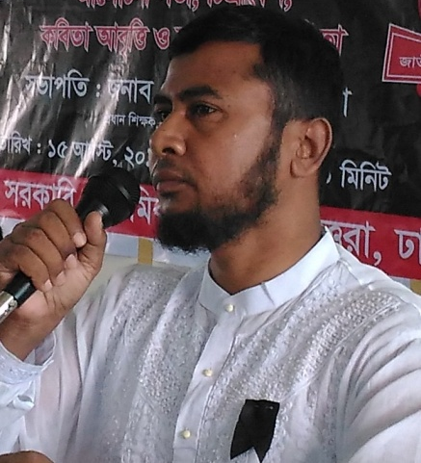
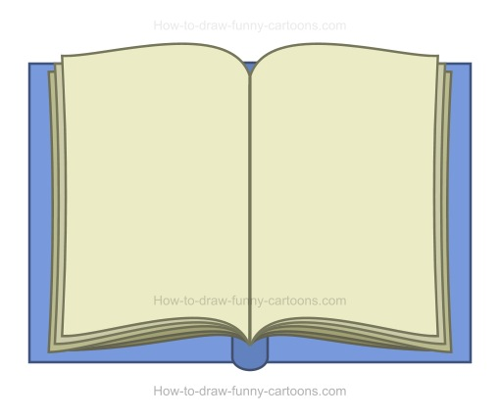
A. Gaffar Mozumder
Senior Teacher (English)
Uttarkhan Govt. Secondary School
Uttara, Dhaka
01734101510
# Class: Seven
# Sub: English 1st
# Date: 19. 08. 2017
gaffarsir21@gmail.com
Gaffar Mozumder

Slide 3
Declaration
Evaluation
Outcomes
Home Work
Presentation
Thanks

Slide 4
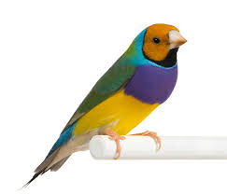
Disorder

Slide 5
In order

Slide 6
Today’s Lesson
Rearranging Sentences

Slide 7
Learning Outcomes
By enjoying the lesson
the students will be able to
* Arrange some jumbled sentences.
* Write a story/incident in correct sequence.

Slide 8
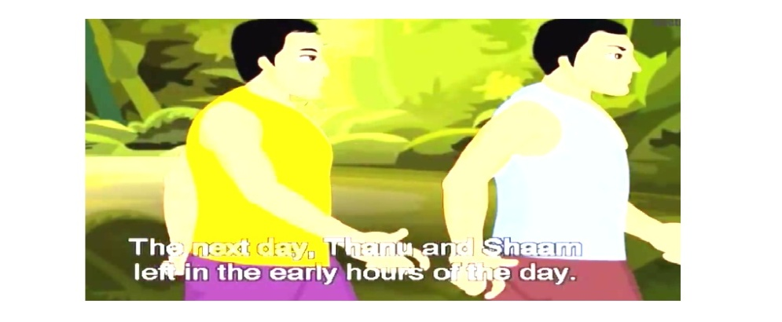
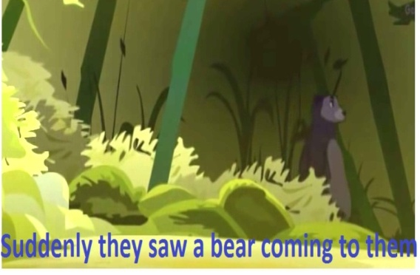
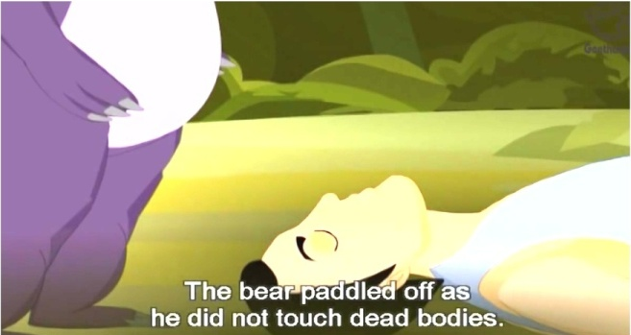
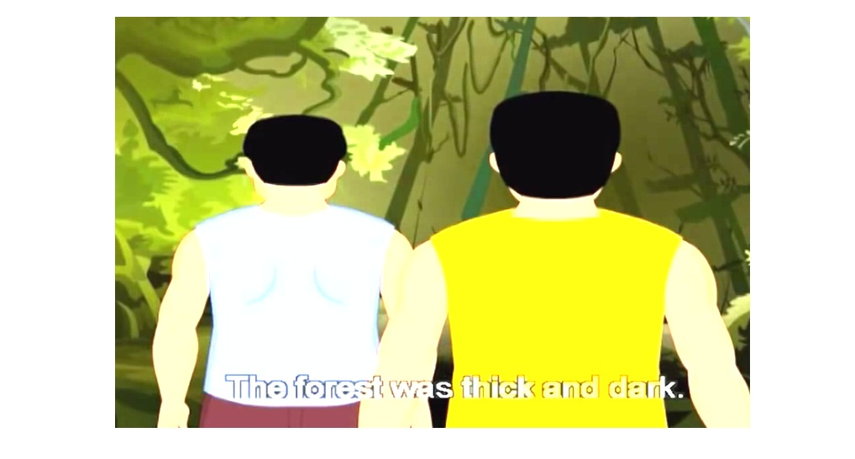
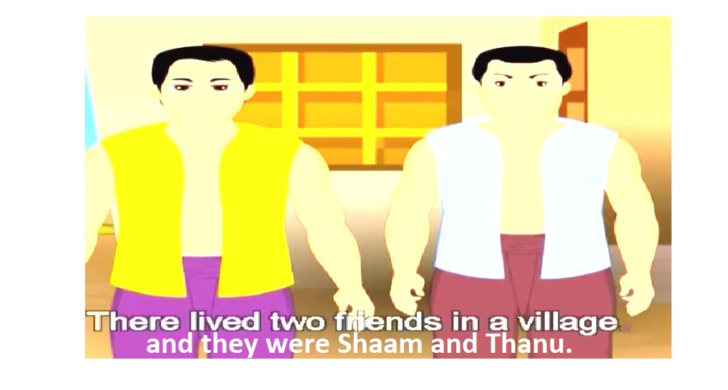
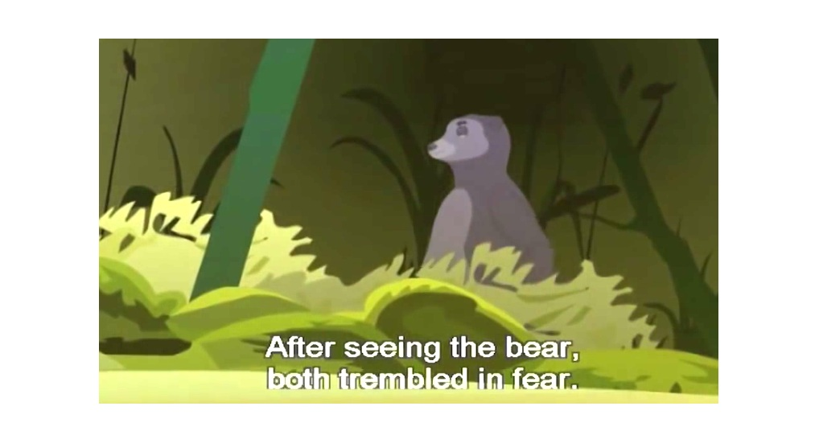
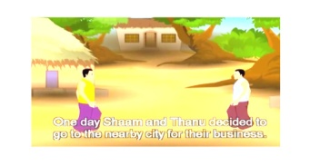
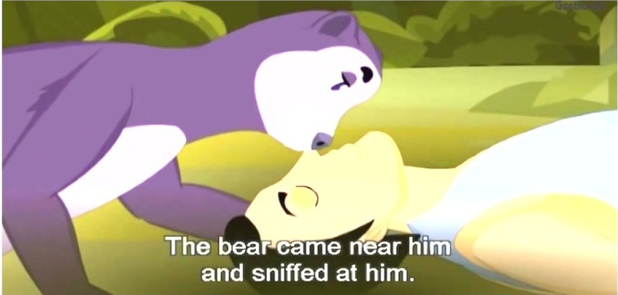
b)
c)
a)
The next day, Thanu and Shaam left in the early hours of the day
e)
g)
d)
f)
h)
i)
j)

Slide 9
e)
h)
a)
g)
f)
d)
b)
j)
i)
c)

Slide 10
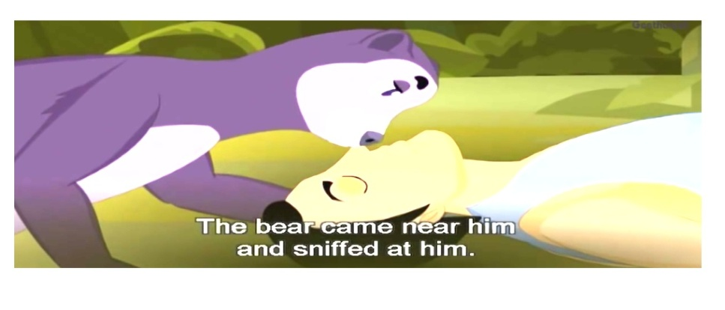
Evaluation
Now rearrange these pictures.
f)
i)
h)

Slide 11
Homework
a) He could not understand the rules of grammar
b) The teacher began to teach him.
c) He did not know their meaning.
d) The man grasped only three words.
e) The teacher realized him.
f) There lived a man in a village.
g) He had a great attraction to English.
h) He went to a teacher.
i) The man was dull headed.
j) He learned ‘yes’, ‘no’ and ‘very well’.

